Slide 1

Exploratory Data Analysis (EDA) on Aspiring Mind Employment Outcome 2015 (AMEO) Dataset

Slide 2
About me
Hello, I’m varshini seetha currently pursuing a Master of Computer Applications (MCA), which has equipped me with a strong foundation in computer science, programming, and information technology. Throughout my academic journey, I have gained proficiency in various programming languages, database management systems, and software development methodologies.
I want to learn data science because it offers the opportunity to unlock valuable insights from data, driving innovation and making a positive impact across diverse industries.
I currently do not have any professional work experience in data science, but I am eager to apply my academic knowledge and skills to practical projects, contributing meaningfully to the field.
Below are my GitHub and LinkedIn profiles:
GitHub: https://github.com/varshini1008/Data-analysis-1
LinkedIn: https://www.linkedin.com/in/seetha-varshini/

Slide 3
Agenda:
Business Problem and Use case domain understanding:
The AMEO dataset offers key insights into the employment outcomes of engineering graduates, benefiting stakeholders like educational institutions, recruiters, and policymakers. Understanding these trends aids in shaping recruitment strategies, skill development initiatives, and career counseling efforts for aspiring graduates.
Objective of the Project:
The objective of this project is to perform Exploratory Data Analysis (EDA) on the AMEO dataset to gain insights into the employment outcomes of engineering graduates. Through data visualization and analysis, we aim to understand salary distributions, job titles, job locations, skill assessments, and other relevant factors impacting the employment landscape.
Dataset:
https://docs.google.com/spreadsheets/d/1yKll2Vg_mRRrNP_yrUaGr53y1VZMygQo/edit#gid=1768379993

Slide 4
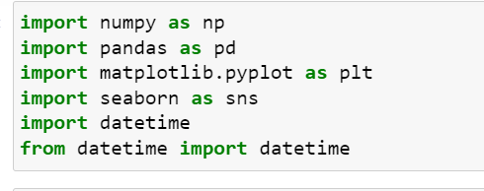
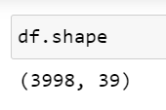
Exploratory Data Analysis:
Data manipulation:
Importing all the libraries which are necessary
Reading csv file and the shape of the file is as below:
The dataset consists of 3998 rows and 39 columns. Performed some data cleaning steps such as changing the datatypes and checking if the dataset consists of null values, duplicates, etc….

Slide 5
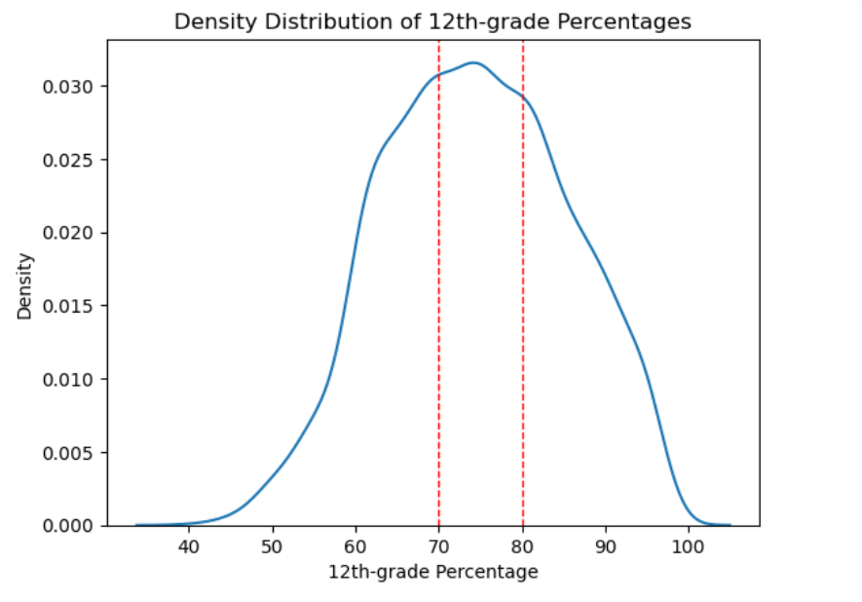
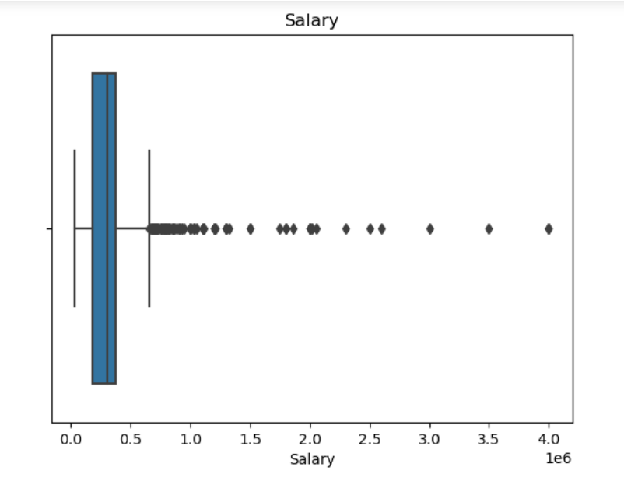
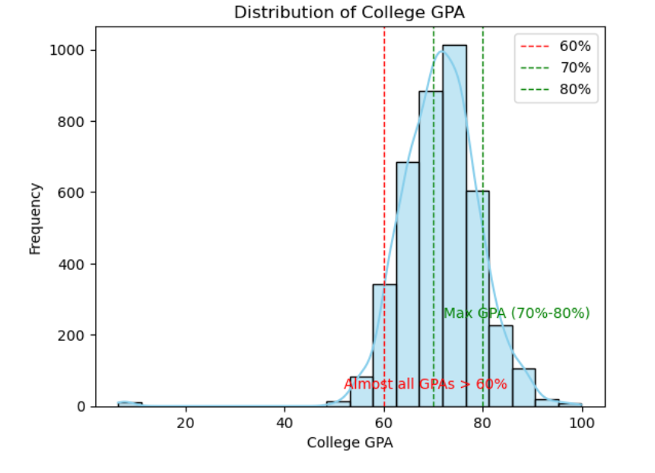
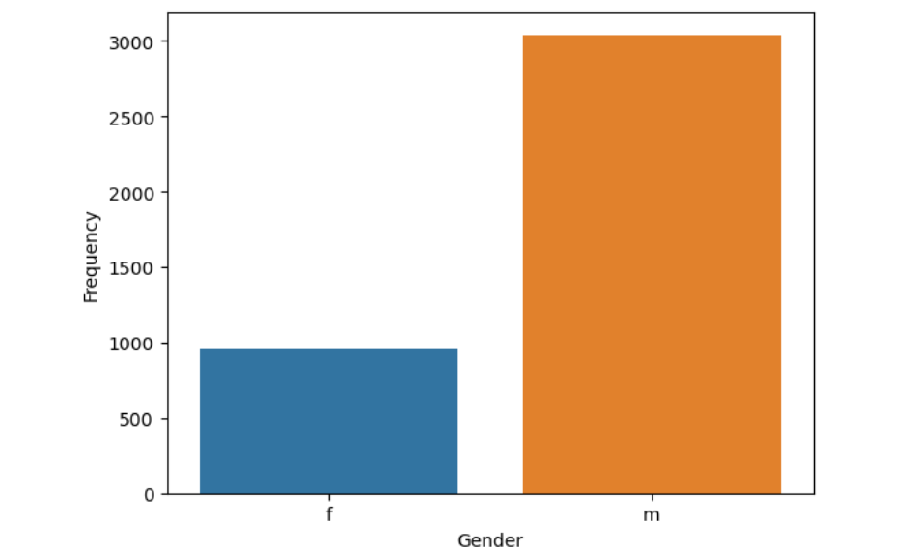
Univariate analysis:
From the above boxplot there are extreme outliers
Majority of the employees completed their 12th graduation in the year 2009
This code will create a KDE plot showing the density distribution of employees' 12th-grade percentages. Area under the curve represents the density. Vertical lines are added at 70% and 80% to highlight the common range.
From the above graph we can say that there are more number of males compared to females

Slide 6
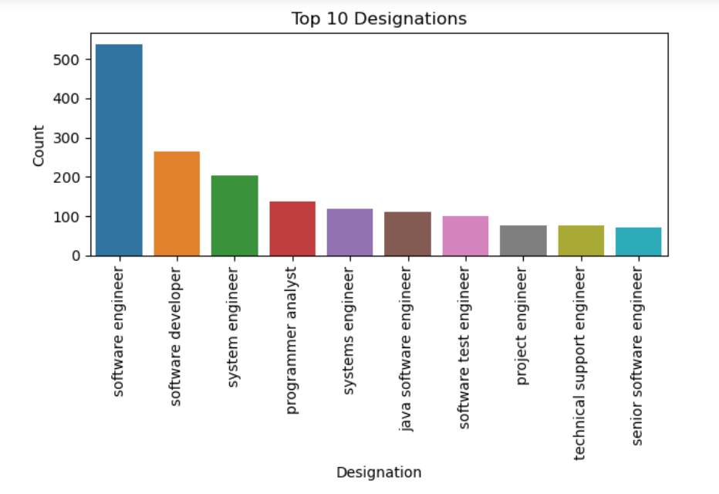
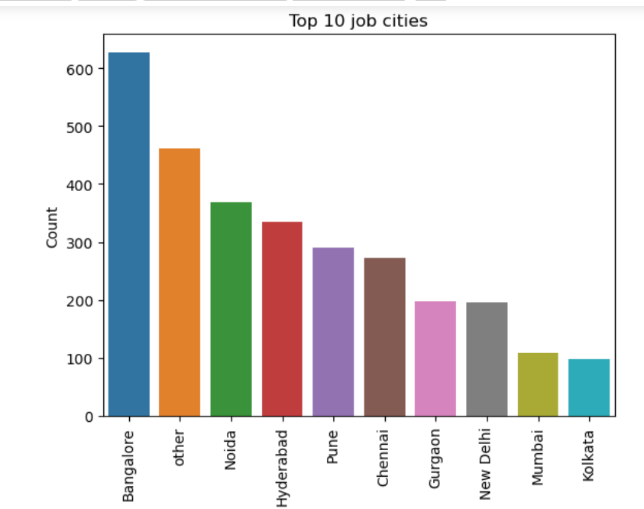
Univariate for categorical Columns:
Software engineering is the top most designation and followed by software developer
The bar plot of job cities represents the top 10 job cities and Bangalore is top

Slide 7
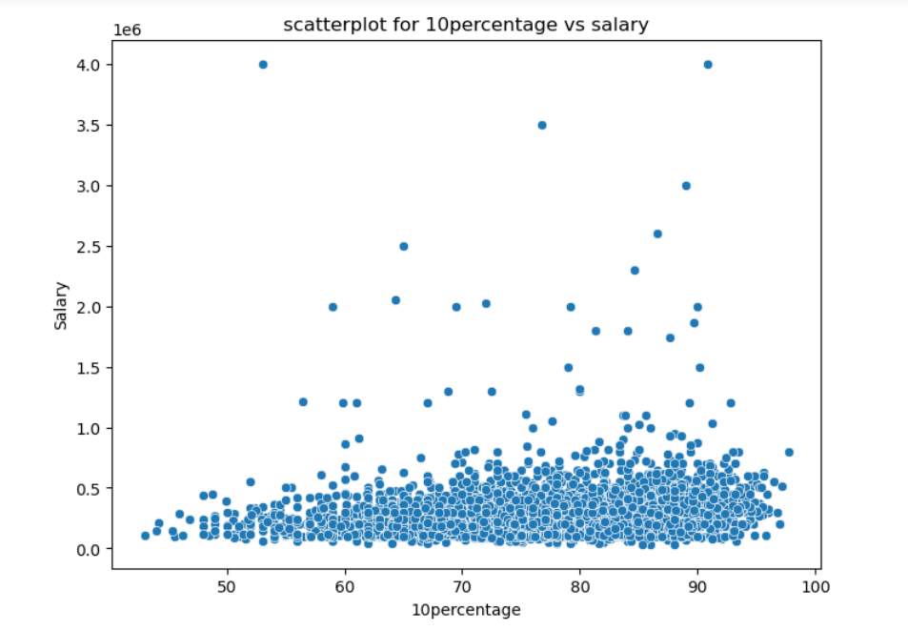
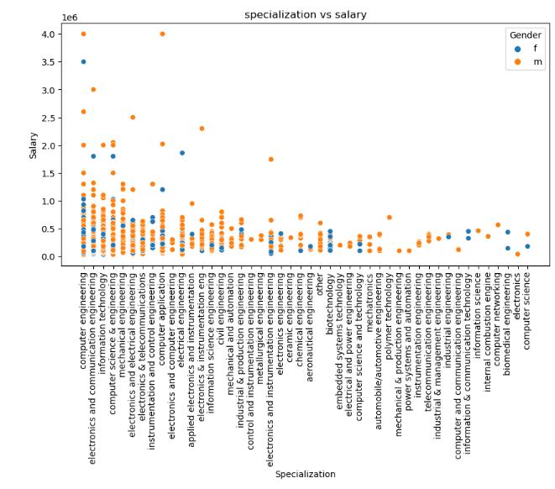
Bivariate analysis:

Slide 8
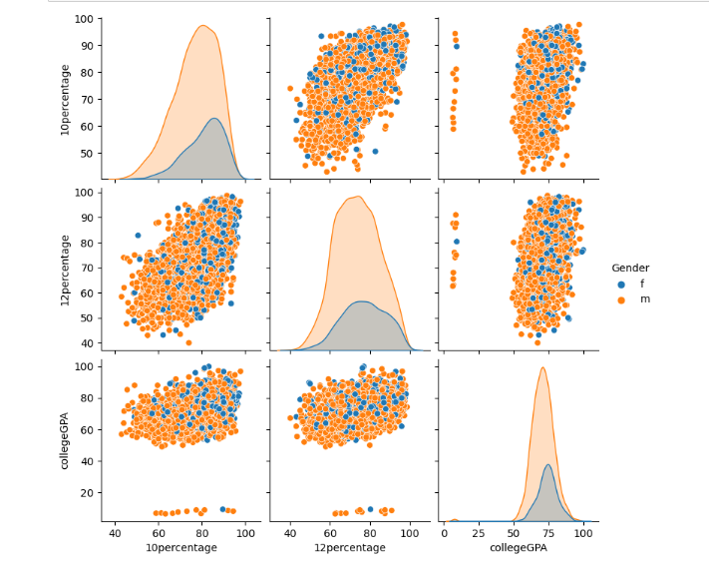
Pair plot:
This pair plot tells about all the employee's percentages and it shows the difference of male and female.

Slide 9
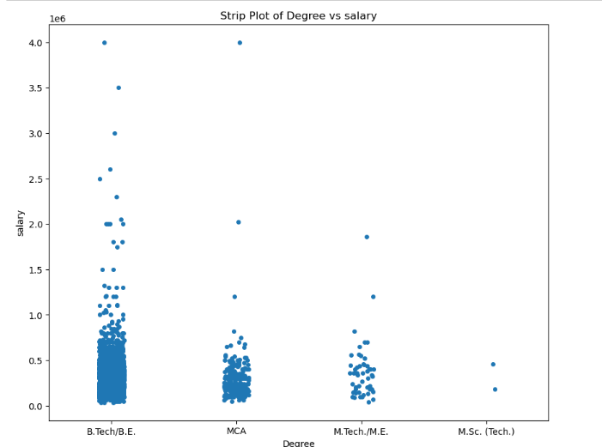
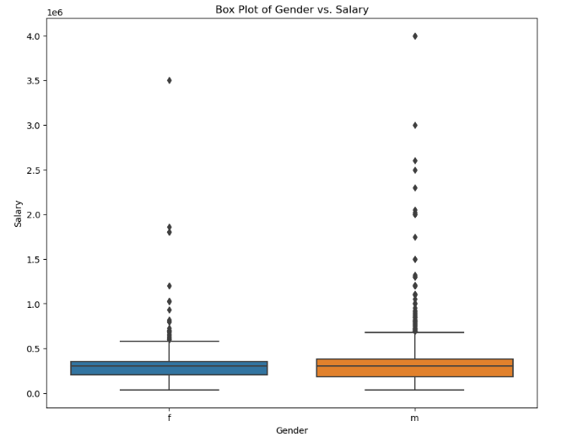
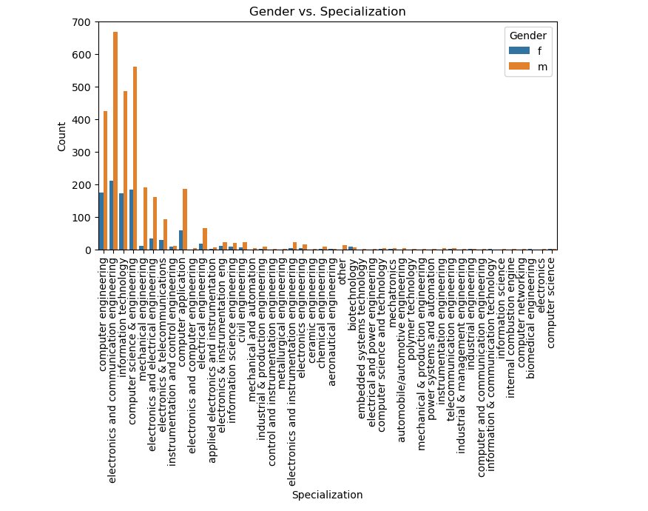

Slide 10
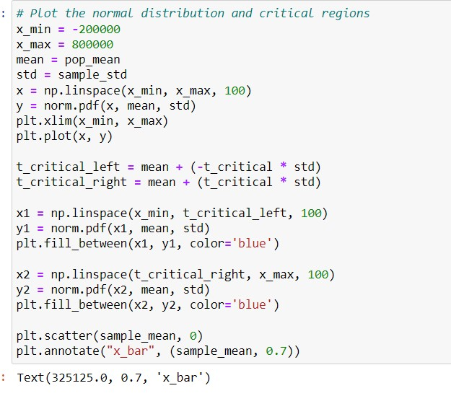
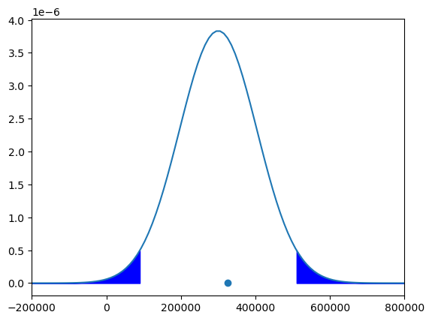

Slide 11
Conclusion:
Through rigorous data analysis and visualization, we gained valuable insights that can inform stakeholders such as recruiters, educators, and policymakers in making informed decisions regarding recruitment strategies, skill development initiatives, and career guidance for engineering graduates.
This project serves as a compelling demonstration of the power of data analysis in uncovering actionable insights and informing decision-making processes in diverse domains, ultimately contributing to the enhancement of employment outcomes for engineering graduates.

Slide 12

THANK YOU

